Slide 1
R_{x}eaching the Future:
Your Pharmacy Career Awaits!
Presenter Name, credentials, (preferred pronouns)
Presenter Title
Presenter Organization, City
Email

Slide 2
*DELETE THIS SLIDE*
This PowerPoint is compiled of general information about pharmacy, pharmacists, and pharmacy careers. This general outline is to support you in presenting a comprehensive presentation to middle/high school students about the pharmacy profession.
Please feel free to edit, delete, remove, and customize the contents of this presentation.
Content:
General pharmacy overview
Potential pharmacy careers
Qualities of a pharmacist
Path to PharmD
Pharmacy Student testimonials
Slides 25-29 are related to pharmacy technicians
Slides 31-36 are an interactive activity

Slide 3
*DELETE THIS SLIDE*
This PowerPoint is compiled of general information about pharmacy, pharmacists, and pharmacy careers. This general outline is to support you in presenting a comprehensive presentation to middle/high school students about the pharmacy profession.
Please feel free to edit, delete, remove, and customize the contents of this presentation.
Pharmacy testimonials:
Pharmacy student and professional testimonials available via Pharmacy Student and Resident Resource Page (link: here)
Consider referring to video testimonials during your presentation

Slide 4
{Presenter introduction}
Who are you?
What is your job?
What has been your career path?
What skills make you good at your job?

Slide 5
What is pharmacy to you?
Notes:
Question directed at students

Slide 6
About Pharmacy
Pharmacy is a blend of science, health care, ethics, technology, and business.
Pharmacists are medication experts who enhance patient care and promote wellness.
Notes:
AACP
Mayo Clinic College of Medicine and Science

Slide 7
Patient Care Where there’s a patient, there’s a pharmacist
Collect patient health information social history, medication history (Rx and OTC)
Assess patient’s health: risk factors, medication use, health literacy, access to care
Develop medication treatment plan in collaboration with other health care professionals
Administer immunization
Wellness Services: smoking cessation, blood pressure monitoring
Counsel and educate patients
pharmcacyforme.org

Slide 8
Trusted Profession
‘Most Accessible Healthcare professional’
96.5% of U.S. population live within 10 miles of a pharmacy
Notes:
https://www.japha.org/article/S1544-3191(22)00233-3/fulltext
https://news.gallup.com/poll/467804/nurses-retain-top-ethics-rating-below-2020-high.aspx

Slide 9
Salary and job demand
Median annual salary: $132,750
Job outlook:
3% growth (average)
~13,400 job openings each year for next 10 years
Replacing current workers (retirement, etc.)
Increased demand in hospitals and clinics
2022 U.S. Bureau of Labor Statistics
Notes:
https://www.bls.gov/ooh/healthcare/pharmacists.htm

Slide 10
Variety of Careers variety of settings
Community Pharmacies
Specialty Pharmacies
Hospitals
Clinics
Long-Term Care Facilities
Industry
Research
Poison Control Centers
Government Health Agencies

Slide 11
Community Pharmacy
Ensure safe use of medications through processing prescriptions, point-of-care testing, immunizing and consulting patients, and healthy lifestyle promotion
Medication therapy management (MTM)
Key community health resource
Independent vs. Chain vs. Clinic-, Hospital-,
or Health-System-based
Notes:
ASHP.org
<a href="https://www.freepik.com/free-vector/pharmacy-concept-pharmacist-preparing-selling-drugs-bottle-box-disease-treatment-healthcare-medical-treatment-concept-isolated-vector-illustration_26432893.htm#query=pharmacy%20illustration&position=15&from_view=keyword&track=ais&uuid=4e843671-5e0a-4a7a-99ed-3050b98fb8a7">Image by vector4stock</a> on Freepik

Slide 12
Hospital or Health-System Pharmacy
Many pharmacist positions:
Clinical
Operational
Administrative and Leadership
Diverse settings:
Large academic medical centers
Non-academic health centers
Community hospitals
Rural hospitals
Notes:
ASHP.org

Slide 13
Inpatient Clinical Specialist
Participate in medical team rounding
Directly involved in patient medication decisions
Specialty expertise in many practice areas:
Cardiology
Critical Care
Emergency Medicine
Pediatrics
Oncology
Infectious disease
Psychiatric
...
Click here to hear from infectious disease pharmacist, Lucas Schulz, PharmD, BCIPD
Notes:
ASHP.org

Slide 14
Ambulatory Care Clinical Specialist
Advanced clinical authority
Collaborative Practice Agreement
Broad Scope of Practice (ex. Veterans Affairs)
One-on-one patient counseling
Primary care or specialty care practice
Hypertension
Diabetes
Heart failure
Asthma
Pain management
...
Notes:
ASHP.org
Pharmacyforme.org
<a href="https://www.freepik.com/free-vector/drug-monitoring-abstract-concept-vector-illustration-therapeutic-drug-monitoring-primary-healthcare-ankle-bracelet-clinical-chemistry-medication-level-measurement-blood-abstract-metaphor_12469164.htm#page=4&query=pharmacy%20illustration&position=14&from_view=keyword&track=ais&uuid=66523086-c870-4fa8-8cc3-57d2a4f5371e">Image by vectorjuice</a> on Freepik

Slide 15
Pharmaceutical Industry
Typically do not work directly with patients
Involved in drug development and pharmacy business
Various positions
Medical Science Liaison
Medical Affairs
Research
Manufacturing
Regulation
...
Notes:
ASHP.org

Slide 16
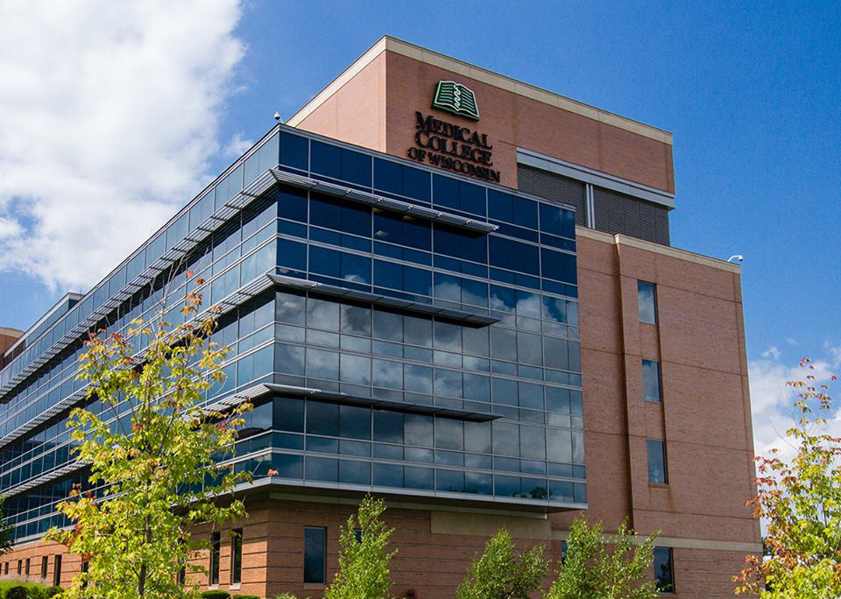
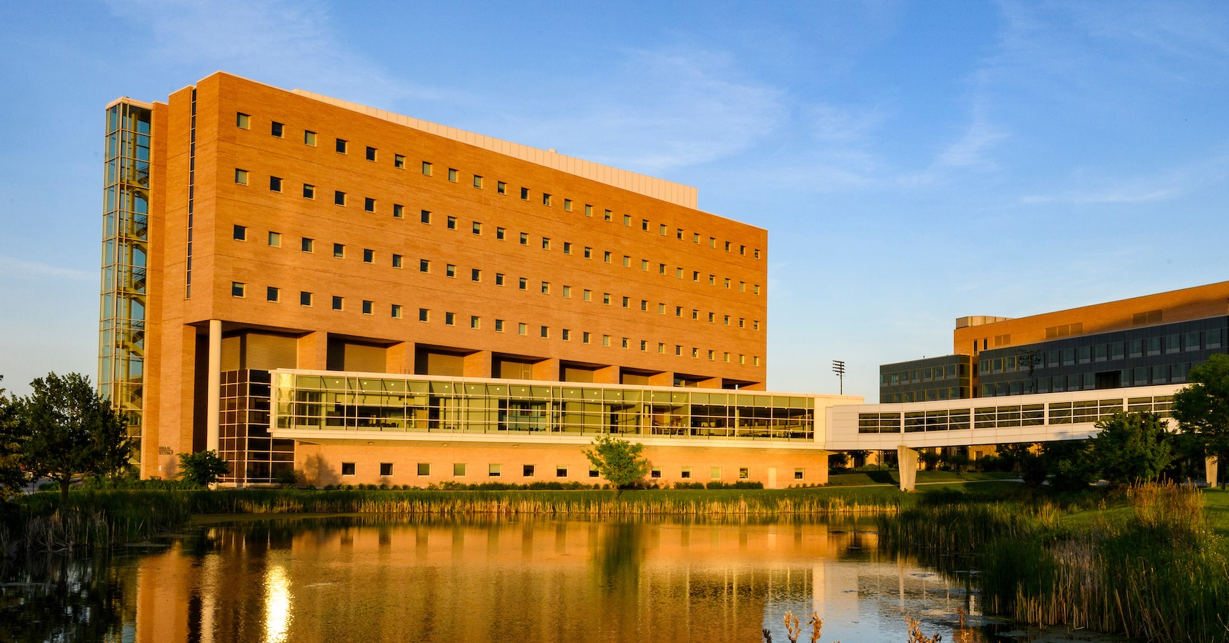
Academic Pharmacy
Medical College of Wisconsin
Teaching responsibilities
Research opportunities
Possible careers:
Professor
Administrator/Associate Dean
Dean
Provision of pharmacy education:
Student pharmacists
Other health professional students (nursing, medical doctors, etc.)
Technicians
Concordia
University of Wisconsin-Madison
Notes:
ASHP.org
Pictures of three Schools of Pharmacy in Wisconsin

Slide 17
Other Pharmacy Career options
Managed Care
Informatics
Nuclear Pharmacy
Specialty Pharmacy
Veterinary Pharmacy
Pharmacogenomics
Long-term Care
Consultant Pharmacy
Population Health
Public Health
Government
Non-Profits
And more!
100+ PHARMACY CAREERS!

Slide 18
Important qualities
Detail oriented
Analytical skills
Communication skills
Compassion
Interpersonal skills
Leadership Skills
Lifelong learning

Slide 19
Pharmacy Degrees
Practice Degrees:
Bachelors Degree in Pharmacy (BSPharm)
No longer available
Doctor of Pharmacy (PharmD)
Research Degrees
MSc: many focus areas
PhD: many focus areas
Dual Degrees (offered by some schools)
PharmD/MPH
PharmD/MBA

Slide 20
Path to PharmD
Pre-Pharmacy Study
2-4 years
Doctor of Pharmacy (PharmD)
3-4 years
Licensure
Residency, Fellowship, or Workforce
NAPLEX
MPJE

Slide 21
Path to PharmD
Pre-Pharmacy Study (2-4 years)
Prerequisites for admission to PharmD programs may vary by school
Generally:
General chemistry and biology
Organic chemistry
Human anatomy and physiology
Biochemistry
Physics
Microbiology
Calculus
Statistics
English composition
Public speaking
Ethics or philosophy
Humanities
Behavioral and social science
Economics

Slide 22
Path to PharmD
PharmD Program (3-4 years)
Foundational coursework in pharmaceutical, biomedical, clinical, and social science approach
Various lengths and structures
3 year PharmD: year-round professional curriculum
4 year PharmD: typical academic structure with winter and summer breaks
Application and Admission Requirements (Typical)
PharmCAS application
Letter(s) of recommendation
College transcripts
Admission interview
Notes:
<a href="https://www.freepik.com/free-vector/college-project-concept-illustration_29659818.htm#query=college&position=18&from_view=search&track=sph&uuid=9afda9b8-9135-4f7e-b572-51e2d3f30e0a">Image by storyset</a> on Freepik

Slide 23
Path to PharmD
Licensure
North American Pharmacist Licensure Examination (NAPLEX)
Pharmacists must pass the NAPLEX to practice as a pharmacist in the United States
Additional State Specific Licensure Requirements
Multistate Pharmacy Jurisprudence Examination (MPJE)
Assess knowledge and application of pharmacy specific laws and regulations
48 boards of pharmacy enforce passing for licensure (including Wisconsin)

Slide 24
Path to PharmD
Residency, Fellowship, and/or Degree (ex. MBA, PhD)
Optional to further enhance skills and expertise
Residency: Clinical health-system, some community options
Fellowship: Industry and research
Workforce
Begin career following graduation and licensure

Slide 25
PHARMACY TECHNICIANS

Slide 26
About Pharmacy Technicians
Pharmacy technician: anyone who is not a licensed pharmacist and, under supervision, administers vaccines, performs technical dispensing functions, compounding, packaging, labeling and storage, pharmacy and inventory management, and/or other activities involved in the practice of pharmacy.

Slide 27
About Pharmacy Technicians
Work environment similar to pharmacists:
Community pharmacy
Hospital
Clinic
Full-time and part-tine opportunities
Salary: $37,790
$18.17 per hour
Influenced by education level and certification
Job Outlook: 6% (higher than average)
Notes:
2022 U.S Bureau of Labor Statistics

Slide 28
Various Technician Roles
Accurately prepare and distribute patient medications
Compound non-sterile and sterile medications
Collect patient information
Process billing claims and assist with prior authorizations
Work directly with patients to obtain medication histories
Use technology to maintain patient records or medication inventory
Support pharmacists with various tasks
Immunizations (with appropriate certification)
*Duties vary depending on job title, setting, location, etc.

Slide 29
Advanced Technician Roles
Ambulatory Care Pharmacy Technician
Informatics Technician
Lead Pharmacy Technician
Pharmacy Purchaser
Tech Check Technician (TCT)
Research Pharmacy Technician
Procurement Technician
Image by pch.vector</a> on Freepik

Slide 30
Certification
Certified Pharmacy Technician (CPhT)
Pharmacy Technician Certification Board
Pharmacy Technician Certification Exam (PTCE)
Eligibility: completion of a PTCB-Recognized Education/Training Program or equivalent work experience (500 hrs as pharm tech)
National Healthcareer Association (NHA)
Exam for Certification of Pharmacy Technicians (ExCPT Exam)
Eligibility: can sit for the ExCPT to obtain NHA CPhT certification if you have earned or are within 60 days of earning a high school diploma or GED or other equivalency test
Wisconsin does NOT require certification of pharmacy technicians.
Pharmacy technicians must formally register with the state, exceptions for some students enrolled in pharmacy school.

Slide 31
Pharmacy: How to get involved
SHADOW
VOLUNTEER
WORK AS A PHARMACY TECHNICIAN
Connect with community pharmacies and health-systems or reach out to local pharmacists and ask about opportunities! Contact the Pharmacy Society of Wisconsin (PSW) for additional support!

Slide 32
Activity – Guess who
I work in a clinic setting and treat multiple patients with chronic conditions. I have one-on-one patient appointments where I gather patient information, review side effects, interpret INR lab values, and make changes to my patient’s warfarin (blood thinner) regimen as appropriate. Who am I?
Cardiologist
Ambulatory Care Pharmacist
Registered Nurse
Physical Therapist
Notes:
Polling tools within the interactive presentation support APP can be utilized.
Rationale for why the correct answer is correct can be spoken/verbalized, but should be included when the correct answer is noted.

Slide 33
Activity – Guess who
I work in a clinic setting and treat multiple patients with chronic conditions. I have one-on-one patient appointments where I gather patient information, review side effects, interpret INR lab values, and make changes to my patient’s warfarin (blood thinner) regimen as appropriate. Who am I?
Ambulatory Care Pharmacist
Anticoagulation clinics are a common setting for these pharmacists who can prescribe medications under a collaborative practice agreement or broad scope of practice.
Notes:
Polling tools within the interactive presentation support APP can be utilized.
Rationale for why the correct answer is correct can be spoken/verbalized, but should be included when the correct answer is noted.

Slide 34
Activity – Guess who
I work in a hospital setting and provide direct patient care educating patients and their families about chemotherapy and how to manage side effects. I ensure correct medication dosing and work closely with nursing staff to coordinate chemotherapy administration time. Who am I?
Oncologist
Oncology Pharmacist
Registered Nurse
Social Worker
Notes:
Polling tools within the interactive presentation support APP can be utilized.
Rationale for why the correct answer is correct can be spoken/verbalized, but should be included when the correct answer is noted.

Slide 35
Activity – Guess who
I work in a hospital setting and provide direct patient care educating patients and their families about chemotherapy and how to manage side effects. I ensure correct medication dosing for the indication and work closely with nursing staff to coordinate chemotherapy administration time. Who am I?
Oncology Pharmacist
Clinics, hospitals, and cancer centers are common settings for these pharmacists. They support all aspects of cancer care.
Notes:
Polling tools within the interactive presentation support APP can be utilized.
Rationale for why the correct answer is correct can be spoken/verbalized, but should be included when the correct answer is noted.

Slide 36
Activity – Guess who
I work with patients in a health-system. I record allergy information and how patients use prescription and over-the counter medications. I update the patient’s profile which must be reviewed by another healthcare professional. Who am I?
Medical Doctor
Inpatient Clinical Pharmacist
Medication History Technician
Certified Nursing Assistant
Notes:
Polling tools within the interactive presentation support APP can be utilized.
Rationale for why the correct answer is correct can be spoken/verbalized, but should be included when the correct answer is noted.

Slide 37
Activity – Guess who
I work with patients in a health-system. I record allergy information and how patients use prescription and over-the counter medications. I update the patient’s profile which must be reviewed by another healthcare professional. Who am I?
Medication History Technician
Technicians in this role are valuable team members in hospital admissions. They effectively collect and document patient information using structured interviews and standardized forms.
Notes:
Polling tools within the interactive presentation support APP can be utilized.
Rationale for why the correct answer is correct can be spoken/verbalized, but should be included when the correct answer is noted.

Slide 38
QUESTIONS?
Notes:
Poster titles should be all capitalized (just like session titles)

Slide 39
Thank You
WANT MORE INFORMATION?
PHARMACY SOCIETY OF WISCONSIN (PSW)
Presenter name
Presenter email
ASHP PHARMACY PROFESSION FAQs
APhA CAREER OPTION PROFILES

